Slide 1
Plants Systems

Slide 2
By the end of this lesson you should be able to:
1. | Explain what the root and shoot systems are.
2. | Explain how water is transported from the roots up to the highest leaf.
3. | Describe how glucose is transported to every cell within the plant.

Slide 3
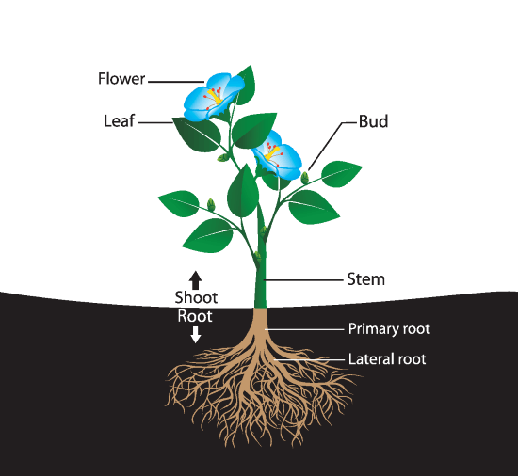
Before we can begin to look at plant transport systems, we must become familiarised with the different structures of a plant.
The portion of the plant above ground is referred to as the shoot system.

Slide 4
The shoot system
The shoot system includes the leaves, stems, flowers, buds and (potentially) fruit.
Hopefully, you remember that the leaves are the major organ involved in photosynthesis.

Slide 5

The stem keeps the plant upright
The stem carries water and nutrients taken up by the roots to the leaves.
It is also what holds a plant upright.

Slide 6
The root system
The portion of the plant underneath the ground is referred to as the root system.
The root system includes the roots and root extensions.

Slide 7
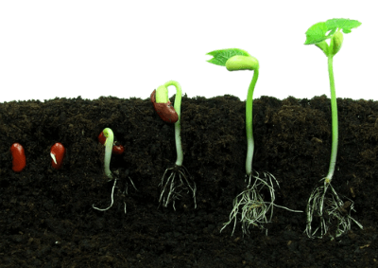
Function of the roots
The roots function to anchor the plant in the soil, as well as absorb minerals and water from the surrounding soil to be used by the plant.

Slide 8
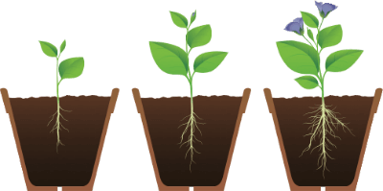
Root hair cells increases surface area for increased absorption
The roots have a large surface area due to the presence of root hair cells. This increases absorption.
See the fine, spindle-like projections, branching off the roots in the image below? These are the root hair cells.

Slide 9
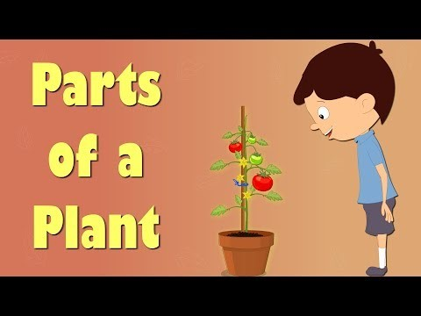

Slide 10
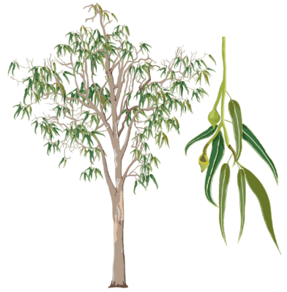
The Xylem
As a plant, you have roots to help you absorb water, but what happens if your leaves need water and they are 100 feet above the ground?
Introducing...the xylem!

Slide 11
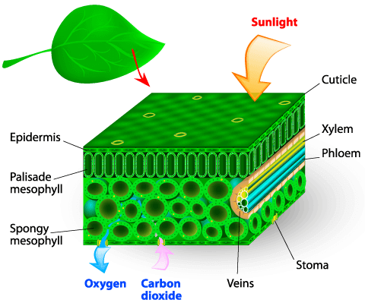
The Xylem II
The xylem of a plant is the system of tubes and transport cells that circulate water and dissolved minerals throughout the plant.
Can you spot the xylem in the image below?

Slide 12
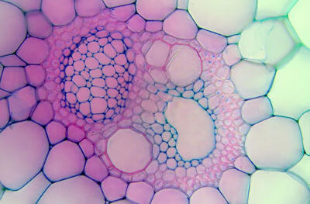
The xylem allows water to move all around the plant
Xylem is made of vessels that are connected end to end for water to move around the plant at maximum speed.
The image below is a microscopic image of a plant cell. The circular structures are xylem.

Slide 13


The xylem goes in one direction only.
Xylem is like a one-way street; it only travels in an upwards direction, from the roots up to the highest leaf.

Slide 14
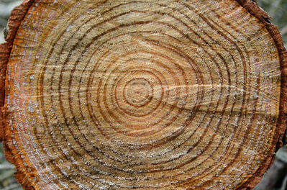
Tree rings are the remains of old xylem
Have you ever noticed circular rings on a tree stump? These rings are the remains of old xylem tissue. One ring for every year the tree was alive.
Next time you see a tree stump, try count how many rings there are to surprise your friends with your newfound knowledge on xylem!

Slide 15
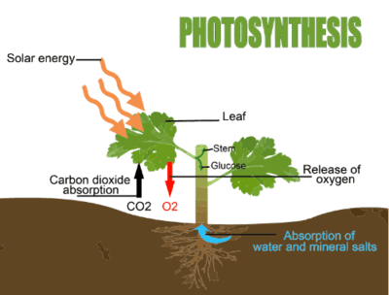
Glucose provides plant cells with energy
You should know by now that glucose (sugar) is produced in the leaves via photosynthesis. This is what provides plant cells with energy.

Slide 16
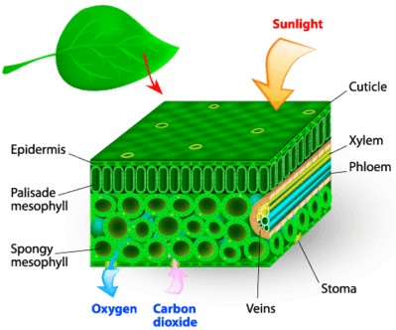
Phloem transports glucose to all the cells in the plant
Most plants have green leaves where photosynthesis happens. When sugars are made, they need to be given to every cell in the plant for energy.
How is this done? The phloem!
Can you spot the phloem on the image below?

Slide 17
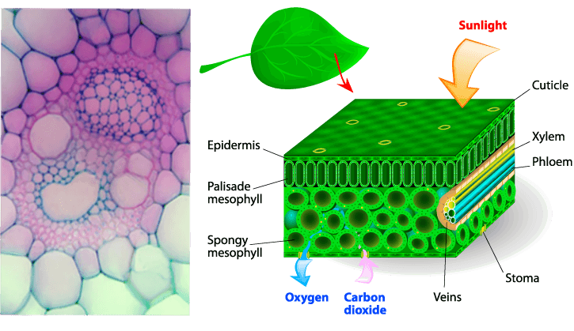
Phloem cells are found throughout the entire plant
The phloem cells are laid out end-to-end throughout the entire plant, transporting the sugars and other molecules created by the plant.
In the below images you can see both the xylem cells and phloem cells, which are next to each other.

Slide 18

The phloem transports glucose around the plant
Unlike the xylem, phloem is a two-way street, transporting glucose up and down the length of the plant.

Slide 19
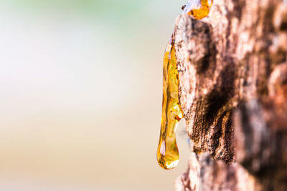
Phloem is always alive
Phloem is always alive, whereas xylem tissue dies after one year and then develops anew (rings in the tree trunk).
What is the best way to think about phloem? Think about sap coming out of a tree. That dripping sap usually comes from the phloem.

Slide 20
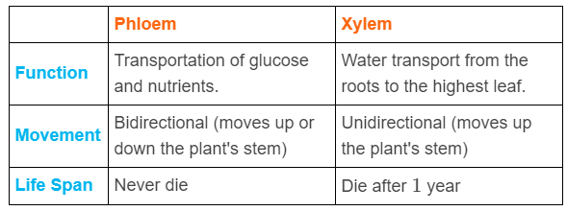
Summary of the function of xylem and phloem

